Slide 1
ASIC design: approach 1
01/08/2021

Slide 2
AES algorithm’s steps

Slide 3
Substitution according to table
Shifting
Multiplication matrix x matrix
XOR between matrix (3) and round key
Upwards shift
Substitution (step 1)
XOR between matrix column and corresponding rc constant
Key
Generation

Slide 4
Encoding
Key Gen.
ROM
(Rijndael
S-box)
ROM
(rc cons)
Subs
(16 blocks)
Shifters
(16 sfts, 4 blks of 4-serial shts)
Key_{i} storage
(4x4 matrix)
Shifters
(16 sfts, 4 blks of 4-serial sfts)
Multipl.
(16 muls, 4 sums)
Galinois’ check
(…)
Comp_mul_2to1.sv
Subs
(16 blocks)
AddRoundKey (XOR)
(16 blocks)
XOR
(16 blocks)
AXI 4 (bus)
Notes:
NOTE: Maybe the “Upward shift” step is only performed with the first column and we only perform and XOR with the rest of the key’s column (check https://towardsdatascience.com/aes-encryption-256-bit-a9ae49cde0b6 for more details).

Slide 5
Extra notes
The ASIC schematic is divided into two parts since the key generation process and the encryption of the data can be done in parallel.
Since the shifters are used simultaneously and in different directions (sidewards vs upwards), I decided to implement two modules
Problem: Galinois’ multiplication
Further investigation should be carried in order to merge the data extracted from the AES’ code and the gates/schematic that will be implemented in the ASIC.

Slide 6
List of components
Overall | .sv done | tb | Working properly
Device | - | -
FIFO | OK | OK | OK
Reg16 | OK | OK | OK
Reg16_4to16 | OK | OK | OK
Reg4 | OK | OK | OK
Reg4_4to1 | OK | OK | OK
Encryption side (enc) | .sv done | tb | Working properly
Shifter (module) | OK | OK | OK
MixColumns (module) | OK | OK | OK
AddRoundKey (module) | OK | OK | OK
ROM (S-box, 256 bits) | OK | OK | OK
ROM (key) | OK | OK | OK

Slide 7
Modules’ input/output signals
Module | Input | Output
ROM | Clk, enable Addr (8 bits) | Data (8 bits) OK
Shifter | Clk, I (8 bits), row (2 bits) | O (8 bits), done
mixColumns | Clk, enable, reset state | State_out, done
addRoundKey | Clk P, k | Out, ok
FIFO | Clk, rst Buf_in Wr_en, rd_en | Buf_out, buf_empty, buf_full, fifo_counter
Reg4_1to4 | Clk, resetn, read I (8 bits) | O (32 bits)
reg16 | Clk, resetn, read I (128 bits) | O (128 bits)
Reg16_4to16 | Clk, resetn, read I (32 bits) | O (128 bits)

Slide 8
16-byte register
Notes:
Creating a ROM verilog:
https://vlsiworld-asic.blogspot.com/2012/02/verilog-code-for-ram-rom.html
https://github.com/Obijuan/open-fpga-verilog-tutorial/wiki/Cap%C3%ADtulo-26:-Memoria-ROM

Slide 9
tb: successful

Slide 10
ROM (module)
Notes:
Creating a ROM verilog:
https://vlsiworld-asic.blogspot.com/2012/02/verilog-code-for-ram-rom.html
https://github.com/Obijuan/open-fpga-verilog-tutorial/wiki/Cap%C3%ADtulo-26:-Memoria-ROM

Slide 11
Tb: successful
ROM v1.0 (reading from file)

Slide 12
Shifter (enc)

Slide 13
tb: SUCCESSFUL
p00 | 00 | o00 | 00
p01 | 01 | o01 | 01
p02 | 02 | o02 | 02
p03 | 03 | o03 | 03
p10 | 04 | o10 | 05
p11 | 05 | o11 | 06
p12 | 06 | o12 | 07
p13 | 07 | o13 | 04
p20 | 08 | o20 | 10
p21 | 09 | o21 | 11
p22 | 10 | o22 | 08
p23 | 11 | o23 | 09
p30 | 12 | o30 | 15
p31 | 13 | o31 | 12
p32 | 14 | o32 | 13
p33 | 15 | o33 | 14

Slide 14
Multiplicator (submodule, enc)
8
8
8
8
8
8
8
8
8-bit number
8-bit number
8-bit number
8-bit number
8-bit number
8-bit number
8-bit number
8-bit number
Comp_mul_2to1.sv
16-bit number
16-bit number
16-bit number
16-bit number
C
16-bit number
Comp_sum_4to1.sv
16-bit number

Slide 15
Multiplicator (module, enc)
1
2
16
8
8
8
8
8
8
8
8
8-bit
8-bit
8-bit
8-bit
8-bit
8-bit
8-bit
8-bit
16-bit
16-bit
16-bit
16-bit
…
C
16-bit
16-bit
P₀₀ (16-bit)
P₀₁ (16-bit)
P₃₃ (16-bit)

Slide 16
tb:

Slide 17
AddRoundKey (enc)
8
8
8
8
8
8
8
8
8
8
8
8
8
8
8
8
8
8
8
8
8
8
8
8
8
8
8
8
8
8
8
8
8-bit
8-bit
8-bit
8-bit
8-bit
8-bit
8-bit
8-bit
8-bit
8-bit
8-bit
8-bit
8-bit
8-bit
8-bit
8-bit
8-bit
8-bit
8-bit
8-bit
8-bit
8-bit
8-bit
8-bit
8-bit
8-bit
8-bit
8-bit
8-bit
8-bit
8-bit
8-bit
8-bit
8-bit
8-bit
8-bit
8-bit
8-bit
8-bit
8-bit
8-bit
8-bit
8-bit
8-bit
8-bit
8-bit
8-bit
8-bit
Notes:
Doubt 1: The output for the XOR modules, having an input of two 8-bit numbers, will be 8-bit or 16-bit?

Slide 18
tb: SUCCESSFUL
Position | P_{xy} hex (dec) | K_{xy} hex (dec) | o_{xy}
00 | 00 (00) | 0A (10) | 0A
01 | 01 (01) | 0A (10) | 0B
02 | 02 (02) | 0A (10) | 08
03 | 03 (03) | 0A (10) | 09
10 | 0A (10) | 0F (15) | 05
11 | 0B (11) | 0F (15) | 04
12 | 0C (12) | 0F (15) | 03
13 | 0D (13) | 0F (15) | 02
20 | 14 (20) | 14 (20) | 00
21 | 15 (21) | 14 (20) | 01
22 | 16 (22) | 14 (20) | 02
23 | 17 (23) | 14 (20) | 03
30 | 1E (30) | 28 (40) | 36
31 | 1F (31) | 28 (40) | 37
32 | 20 (32) | 28 (40) | 08
33 | 21 (33) | 28 (40) | 09
Notes:
Website for manual verification: https://xor.pw/#
Hexadecimal to decimal conversion and vice versa: https://www.rapidtables.com/convert/number/hex-to-decimal.html

Slide 19
=
XOR

Slide 20
Shifter (keygen)

Slide 21
tb: SUCCESSFUL
p00 | 00 | o00 | 01
p01 | 01 | o01 | 02
p02 | 02 | o02 | 03
p03 | 03 | o03 | 00

Slide 22
Screenshots for modules’ schematics

Slide 23
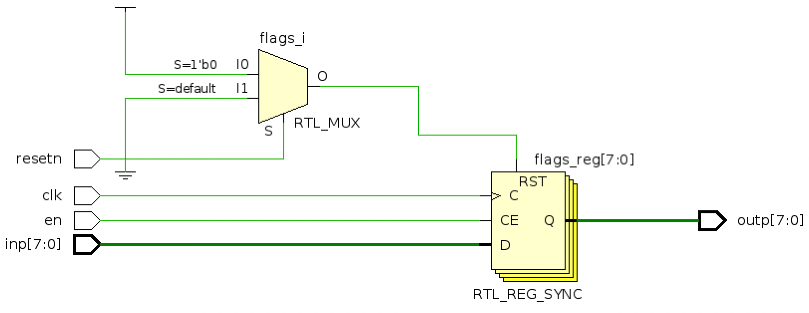
regCTRL

Slide 24
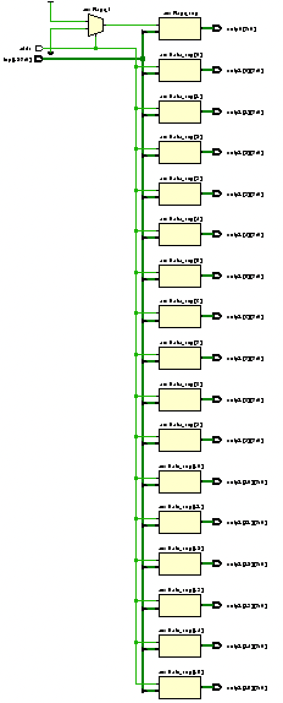
demuxInit

Slide 25
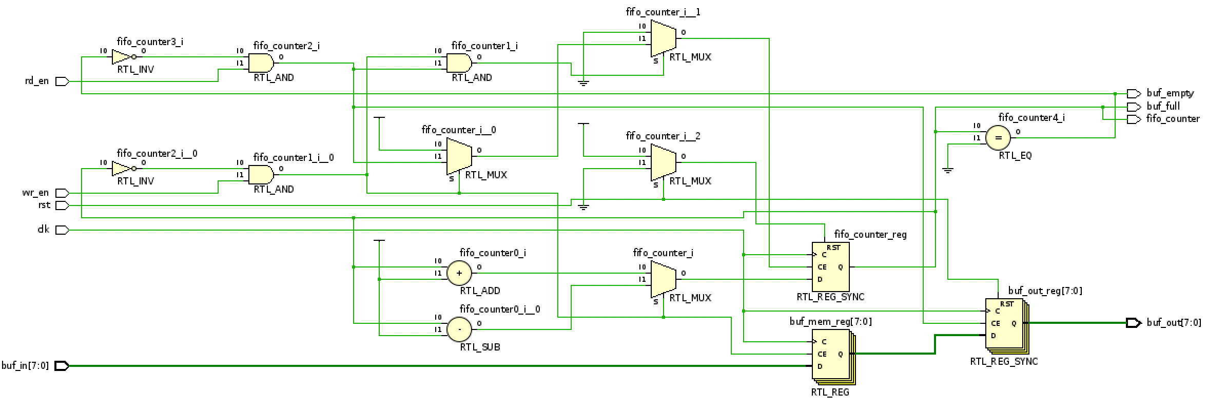
FIFO1

Slide 26
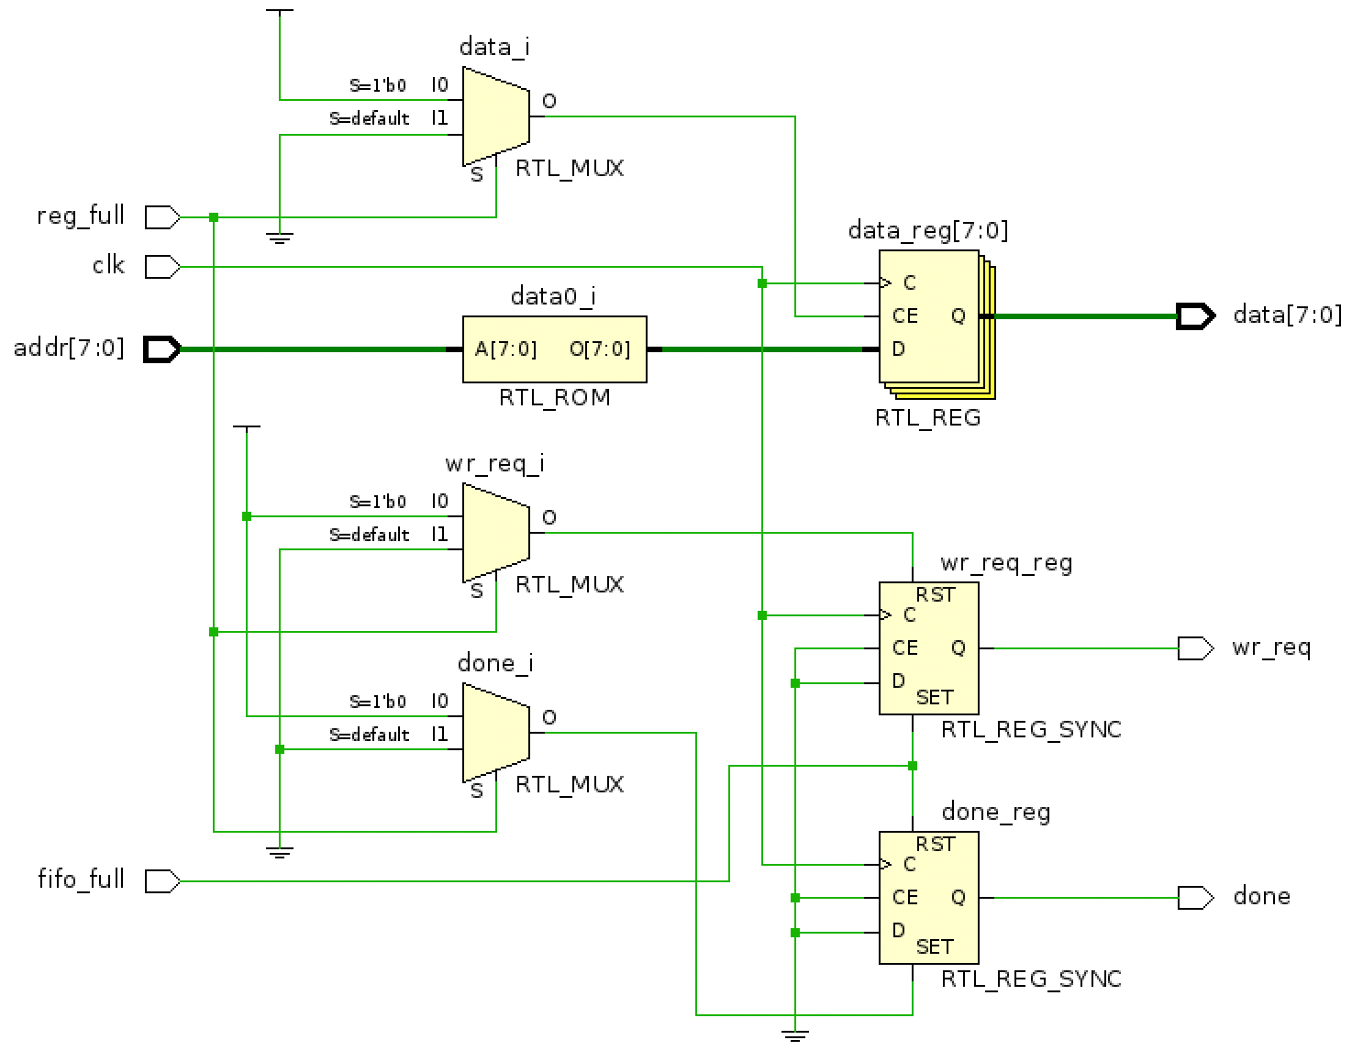
rom256

Slide 27
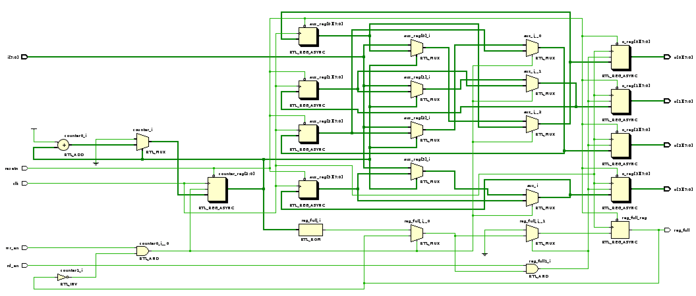
Reg4_1to4

Slide 28
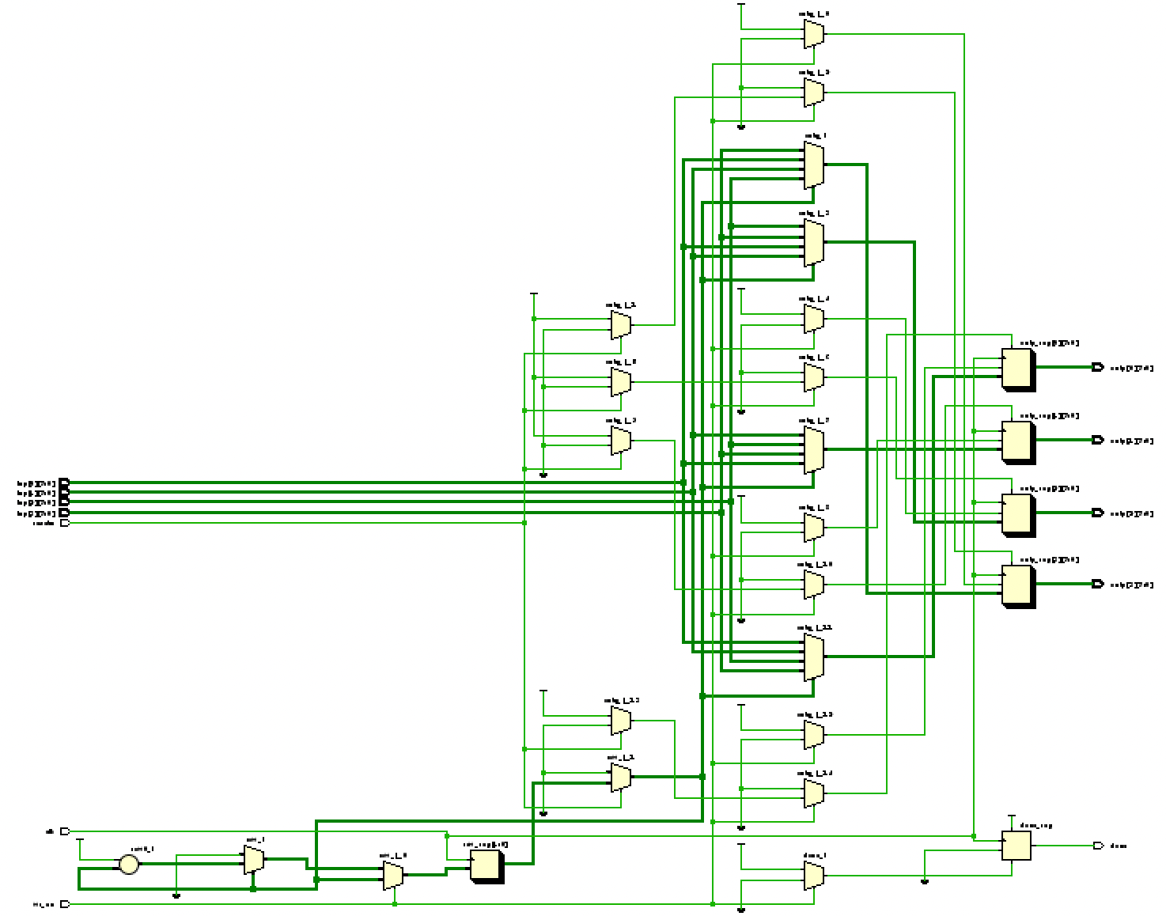
shifter

Slide 29
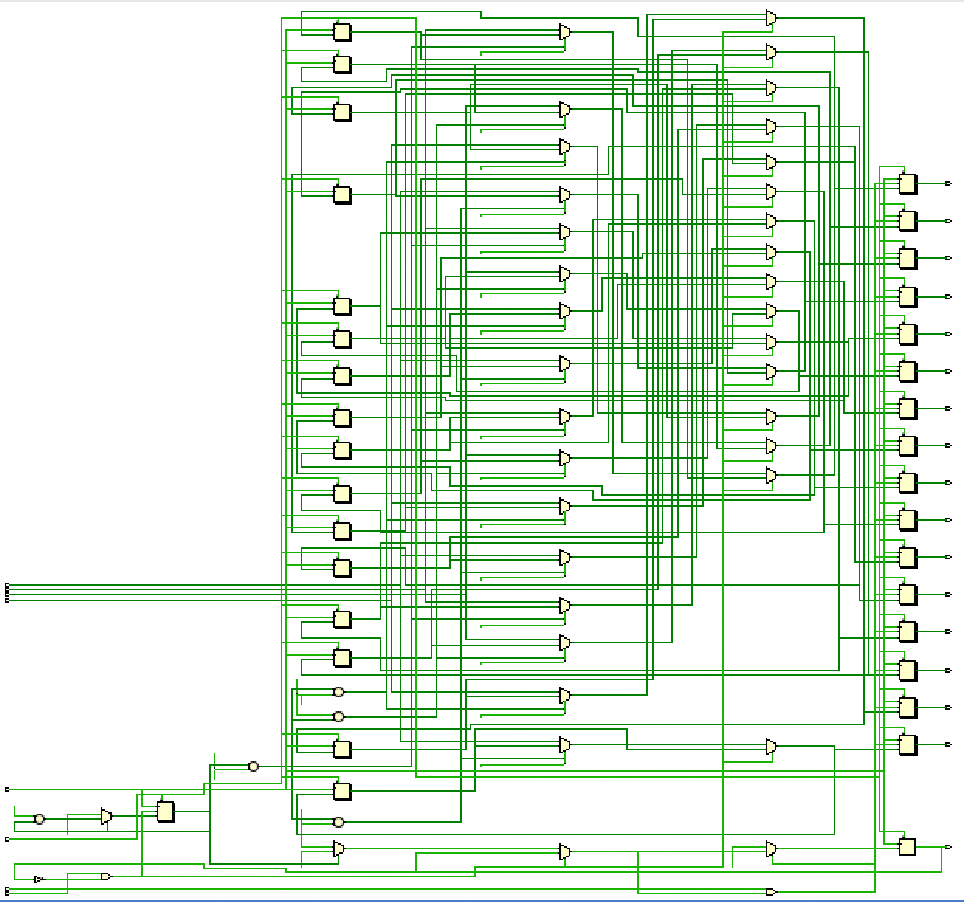
Reg16_4to16

Slide 30
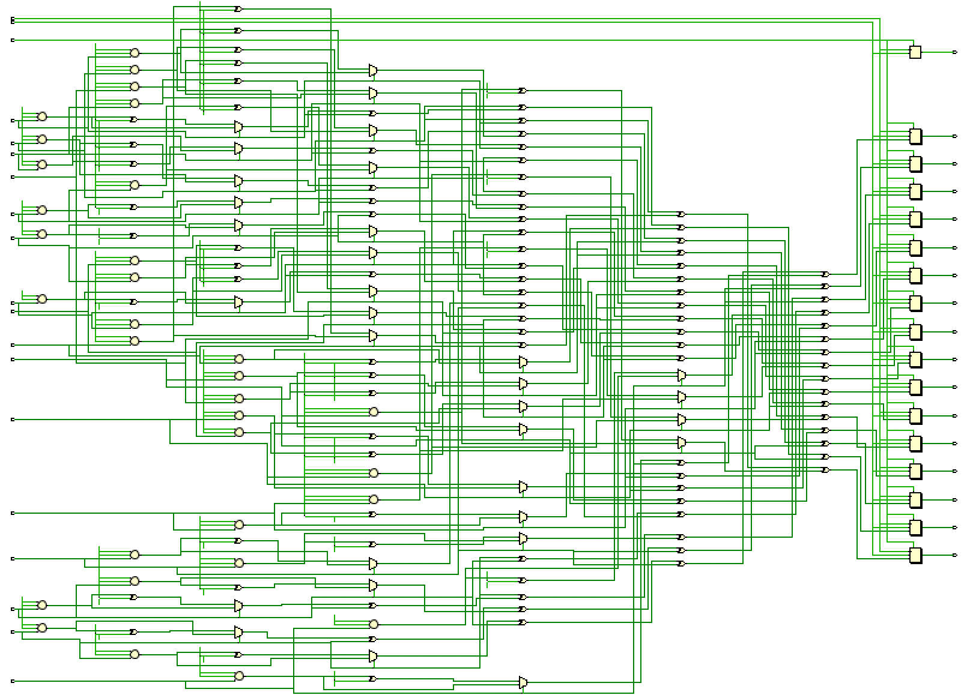
mixColumns

Slide 31
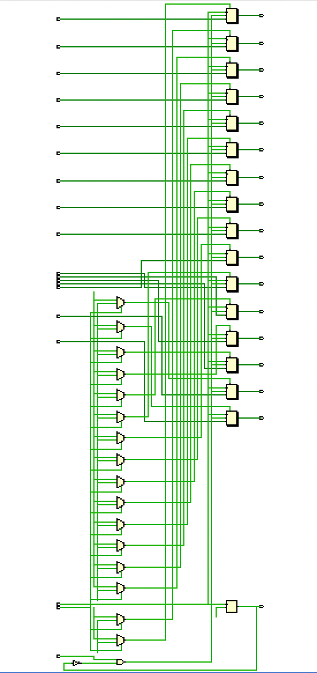
Reg16

Slide 32
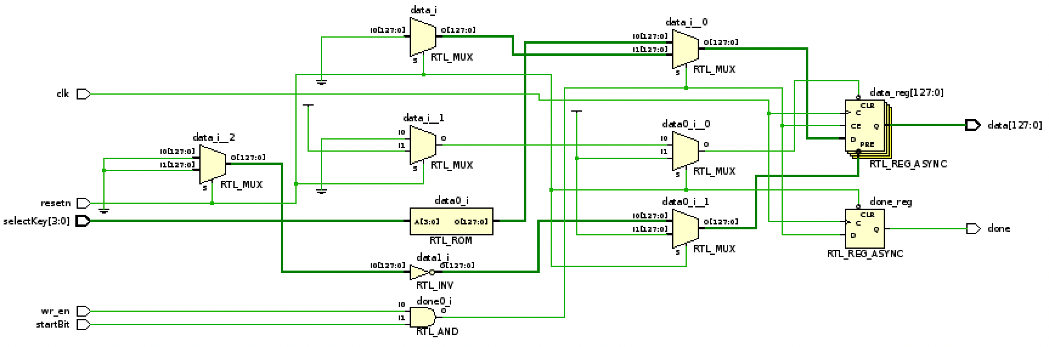
romKey

Slide 33
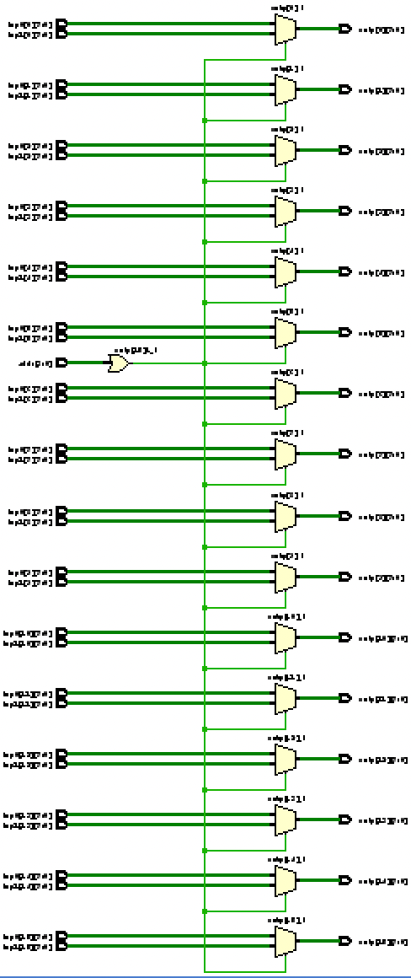
mux_2to1

Slide 34
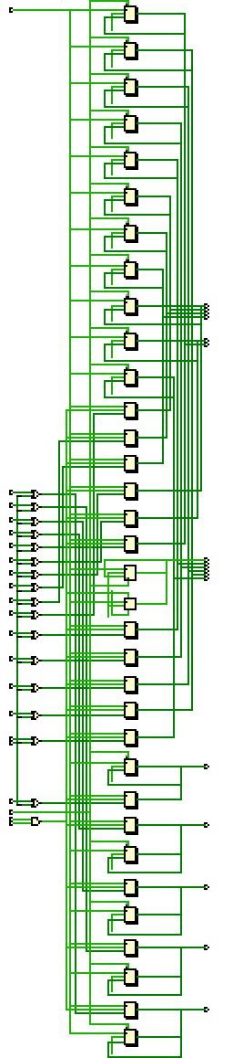
addRK

Slide 35
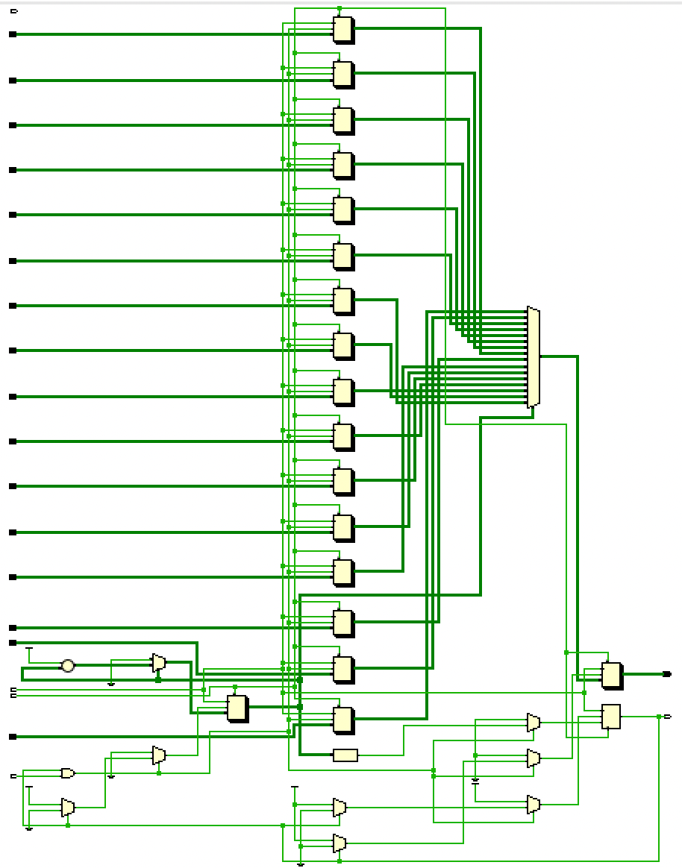
Reg16_16to1

Slide 36
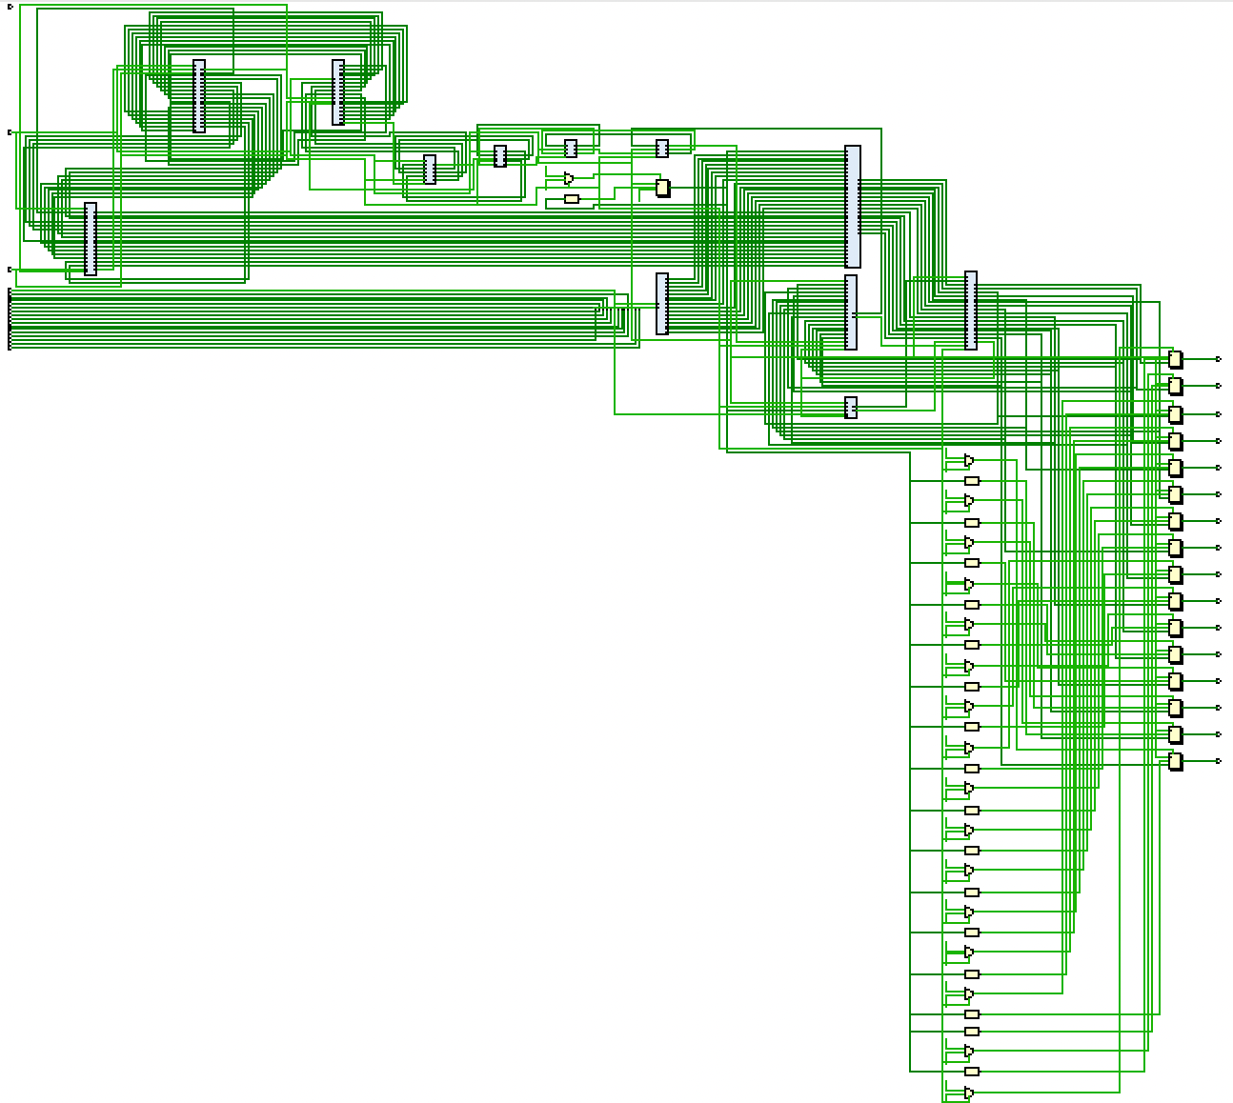
AES256_enc

